Slide 1
Cyber Security Project

Slide 2
Team Members
Mohamed Hosny
Esraa Mohamed
Waad Mahmoud
Aye Hussein
Omnia Zaky
Asmaa Samir

Slide 3
Define project scope and constrain
An inventory system is a process that tracks stock, supplies and sales through an entire supply chain. Companies use inventory systems to ensure they know exactly what items they have available and the location in which they reside.
Inventory systems provide detailed records of new and returned products as they're entering or leaving the warehouse to help companies organize and account for their stock. These systems can also track data such as the number of units, cost per unit, serial number, lot numbers, purchase dates and production dates.

Slide 4
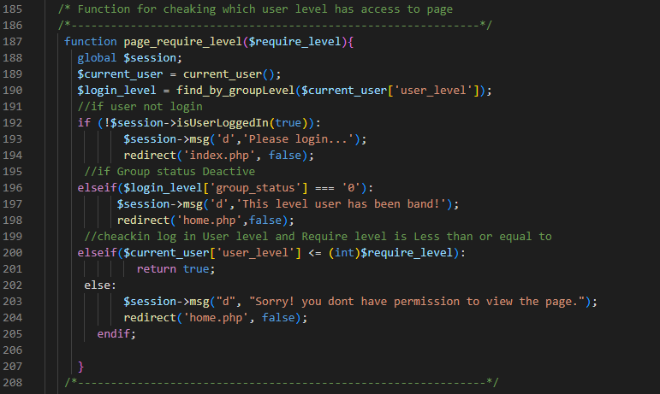
Broken Access Control vulnerability

Slide 5
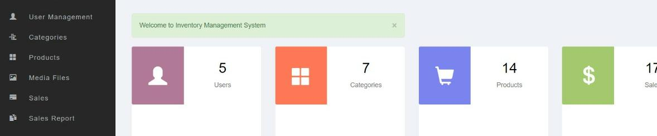
Broken Access Control Scenario
For each person on system have level number “User Level” such as: Admin=1 , Special =2 ,User =3 and so on.
Admin can Access and select all pages in website but user can control on some of them. If he tries to access anything that is not under his control, the message will be displayed on the screen

Slide 6
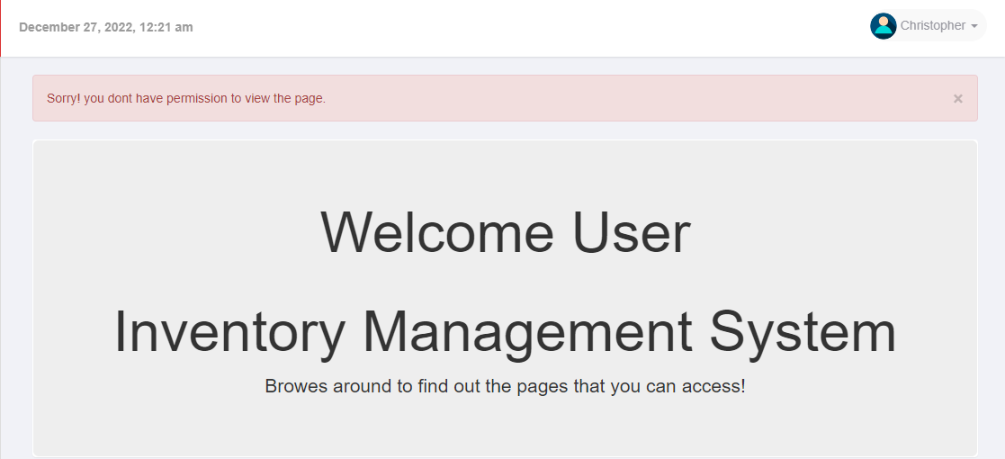
Broken Access Control Scenario

Slide 7
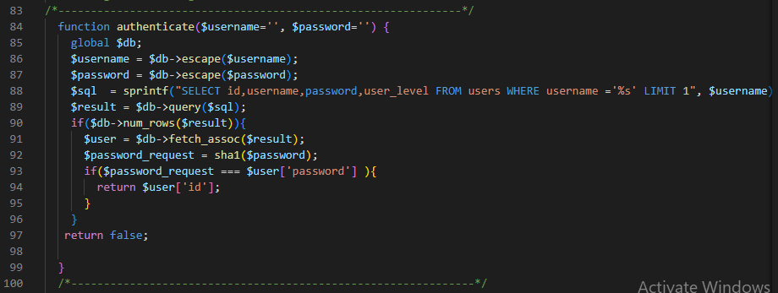
Cryptographic failures vulnerability

Slide 8
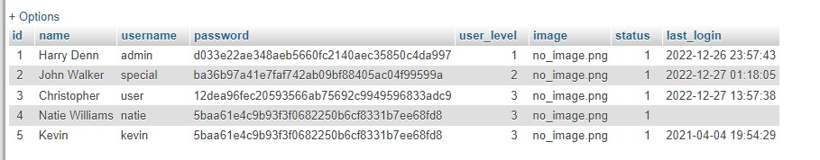
Cryptographic failures vulnerability
The website requires the user to enter the user name and password, and the password is encrypted in the database by the "sha1 algorithm". When the user enters his password, it will be encrypted and compared to the password in the database. If they are the same, the user can log into the site.

Slide 9
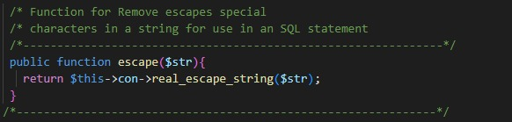
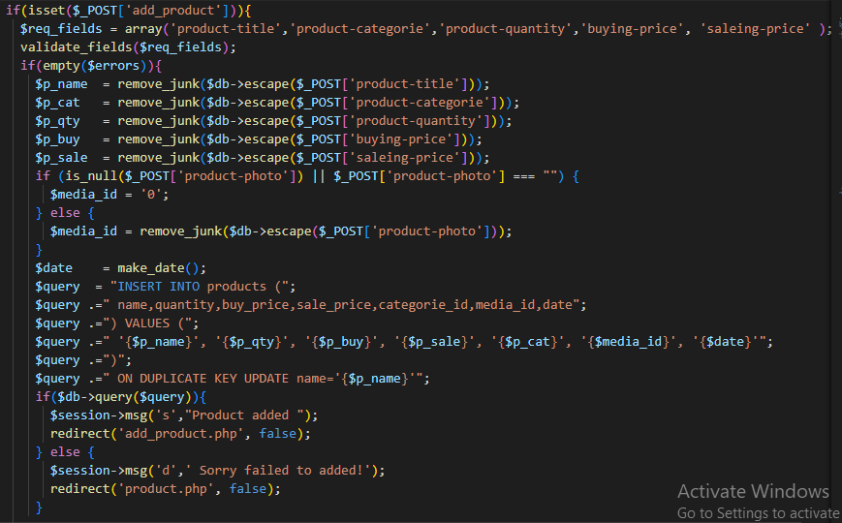
SQL Injection vulnerability

Slide 10
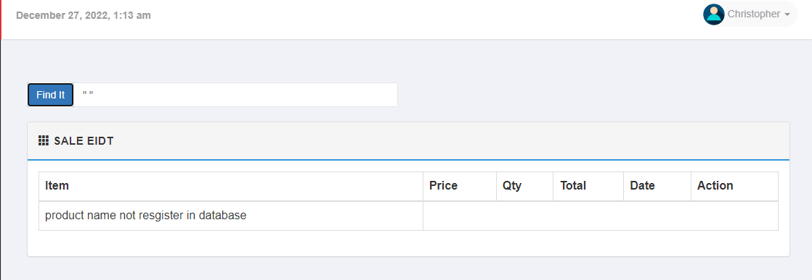
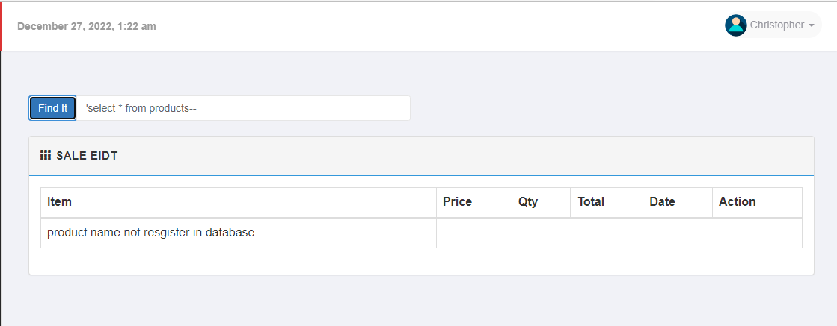
SQL Injection Scenario

Slide 11
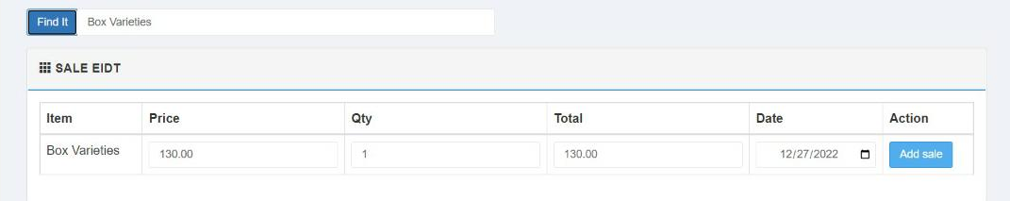
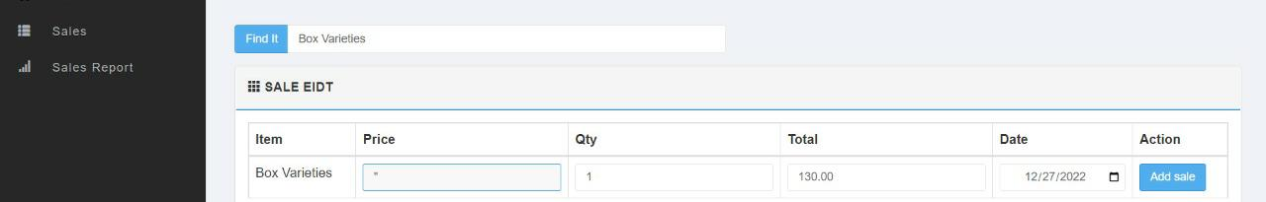
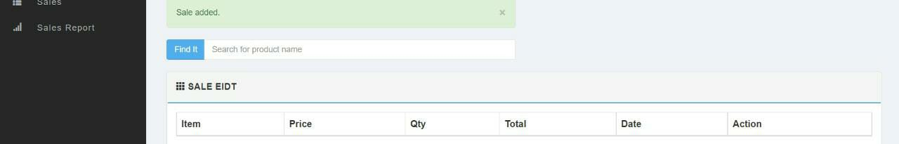
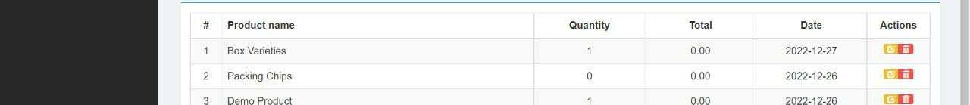
SQL Injection Scenario

Slide 12
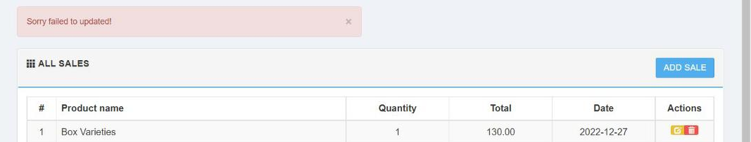
SQL Injection Scenario

Slide 13
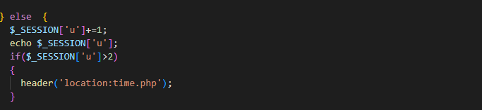
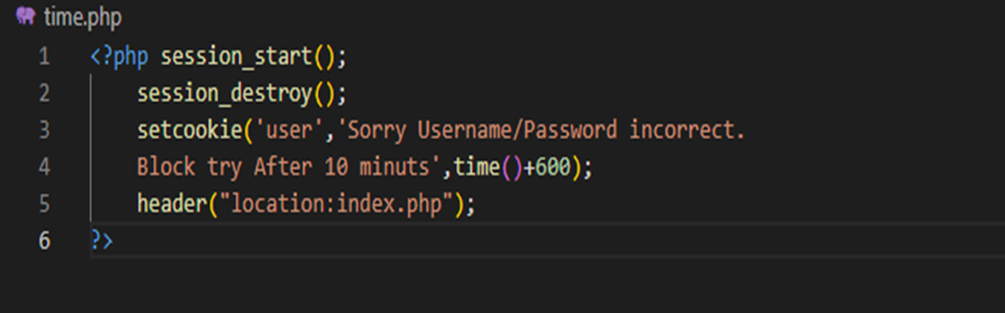
Insecure design vulnerability
If user enter username or password more than 2 times , website will block and user will try to access after 10 minutes

Slide 14

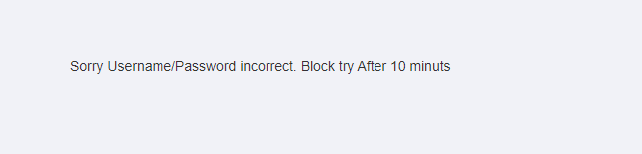
Insecure design Scenario

Slide 15
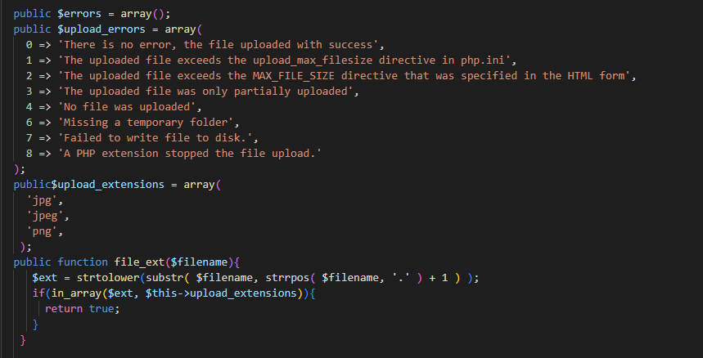
Security Misconfiguration vulnerability

Slide 16
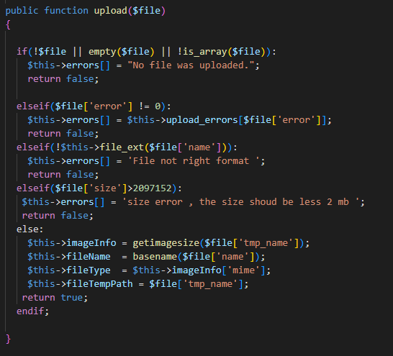
Security Misconfiguration vulnerability

Slide 17
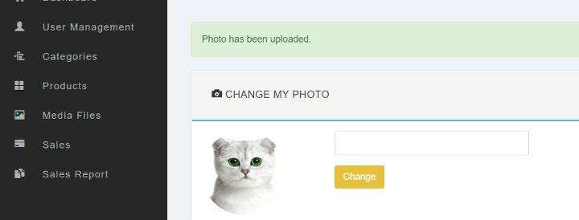
Security Misconfiguration Scenario
If you upload photo with correct format and correct size range it will upload in website

Slide 18
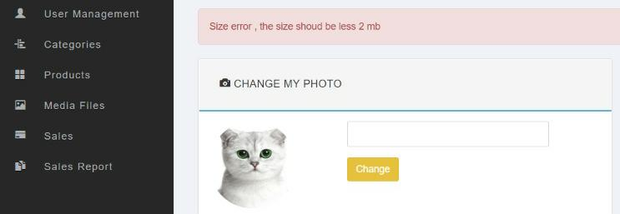
Security Misconfiguration Scenario
If you upload photo with correct format and incorrect size range it will not load in the website and will display an error message.

Slide 19
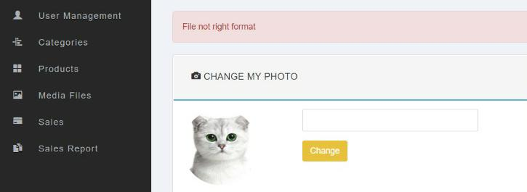
Security Misconfiguration Scenario
If you upload photo with incorrect format and correct size range it will not load in the website and will display an error message.

Slide 20
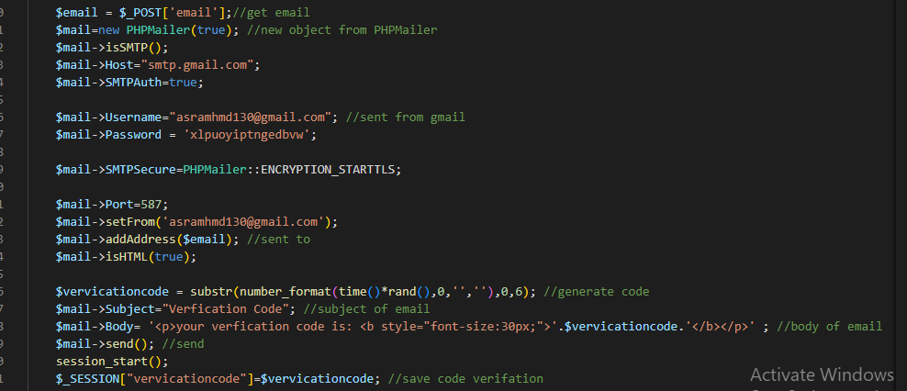
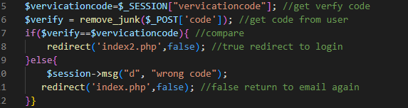
Identification and authentication vulnerability

Slide 21
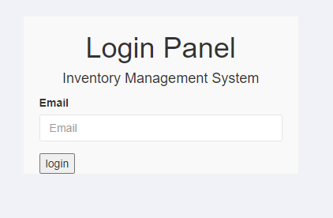
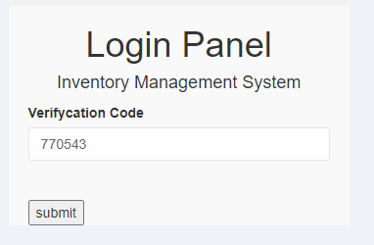
Identification and authentication Scenario

Slide 22
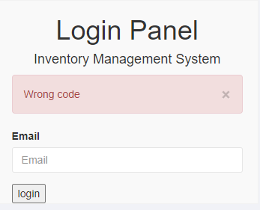
Identification and authentication Scenario

Slide 23


